Slide 1
MyLegion.org
Register an Account
The American Legion
Sons of The American Legion
July 2023
Notes:
MyLegion.org is a member’s web application for American Legion and Sons of the American Legion members. This secure website provides membership information, member management and resources.

Slide 2
About MyLegion
Register with the email address on your membership record.
One account provides all LGN and SAL membership details and administrative tools. All accounts are individual.
Post and Squadron membership is accessed through the individual MyLegion account.
Email must be on your membership record on file at National HQs. Registering with an email not listed as your primary email will not provide access to membership details or leadership resources.
Notes:
All MyLegion accounts are to be registered with the email address on your membership record.
<1> One MyLegion account provides access to all your membership. Membership details for both The American Legion and Sons of the American Legion are included in one account, along with any administrative access provided to adjutants and commanders.
<2> Post and Squadron membership is accessed through your individual MyLegion account.
<3> The Email used during registration must be on your membership record on file at National HQs. Registering with an email not listed as your primary email will not provide access to membership details or leadership resources.

Slide 3
Before You Register
Do you have an email on your membership record?
Open your email to receive a one-time password (OTP) during registration.
Be prepared to create a password that includes:
1 Uppercase Letter
1 Lowercase Letter
1 Number
1 Symbol (!@#$%^&*)
8 character minimum
Notes:
Before registering an account, you may want to verify your email address is correct on your membership record with your post or department leadership. All MyLegion accounts are to be registered with the primary email address. Registering without the email on your membership record will create an account with no member details.
<1> Have your email browser open and ready to receive an email. During registration, a one-time password will be sent to complete the last step of registration with email verification.
<2>Be prepared to create a password. Password requirements include: <3> 1 Uppercase letter, <4> 1 Lowercase letter, <5> 1 Number, <6> 1 symbol, and <7> have an eight (8) character minimum.

Slide 4
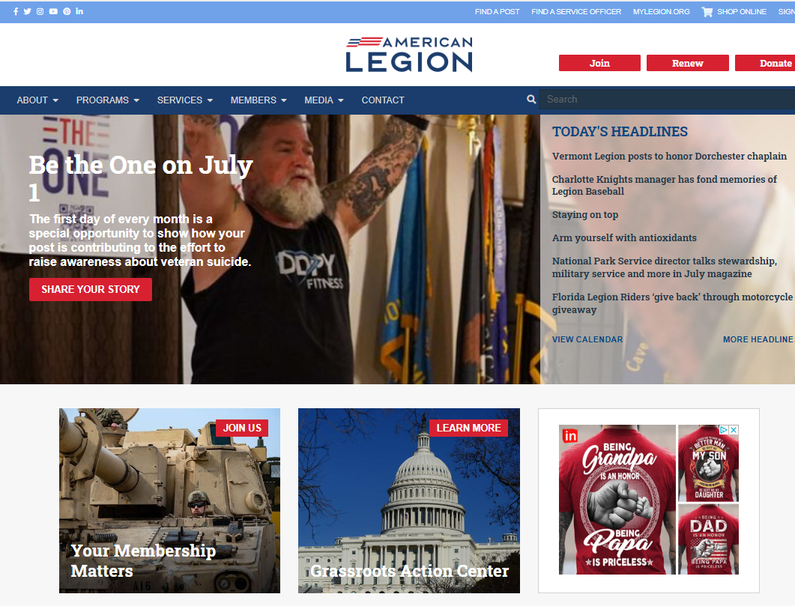
www.legion.org
Notes:
The American Legion National website is legion.org. Located at the top of the page is a link for MyLegion.

Slide 5
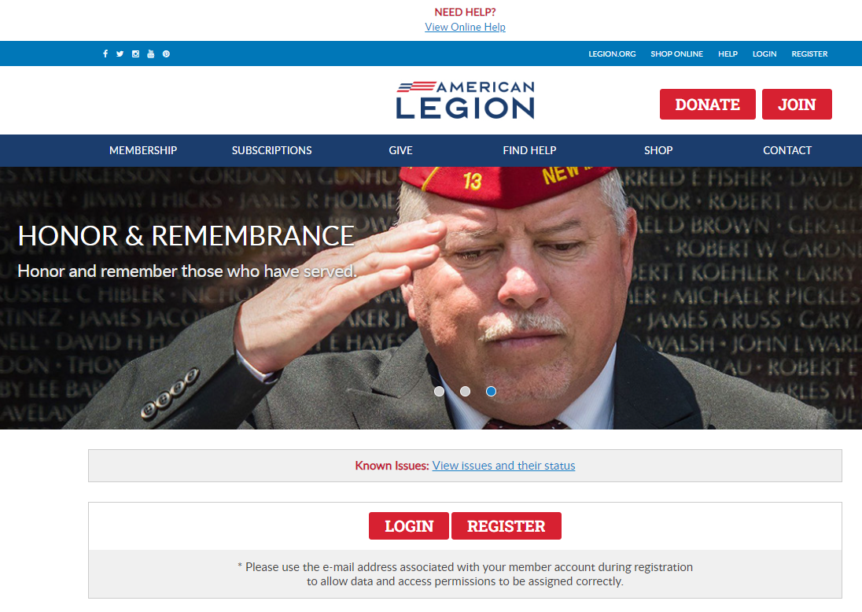
www.mylegion.org
Notes:
In the upper right, click Register. Notice, there may be additional places to access the same tool.

Slide 6
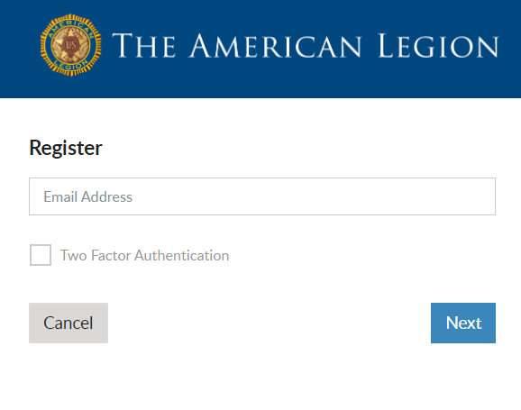
Register a MyLegion Account
STEP 1: ENTER EMAIL ADDRESS
Enter the email address on your membership record.
No Email? Cancel
Create an email, contact leadership to update and return to register.
Notes:
The first step is to enter an email address. An email is required. Have your email open during registration to receive a verification code.
<1> If you do not have an email address do not proceed. Click cancel. Create an email and contact your post adjutant, department headquarters or national customer service prior to registering an account.

Slide 7
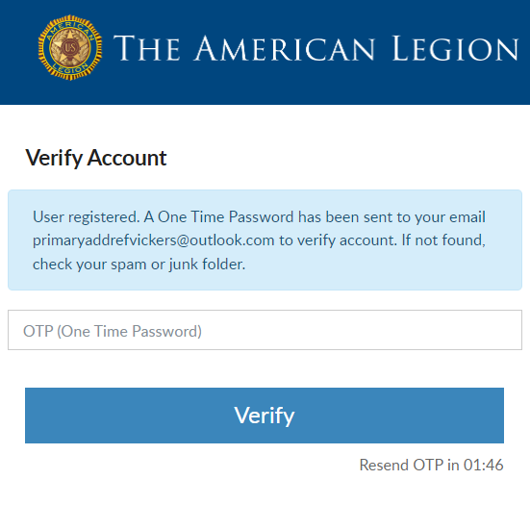
STEP 2: VERIFY ACCOUNT
Do not close this window. Go to email and retrieve One Time Password from. The American Legion Identity Provider.
2-minute limit to enter OTP.
Notes:
Next you will be asked to verify you have access to the email address.
<1> Do not close this window. Return to your email to retrieve a one-time password. This message comes from The American Legion Identify Provider. Check your Spam or Junk folders if you do not see the message within 10-15 seconds. The email will be sent immediately. <2> There is a 2-minute time period to enter the one-time password and verify. This step ensures that you have access to the email address associated with this account.

Slide 8
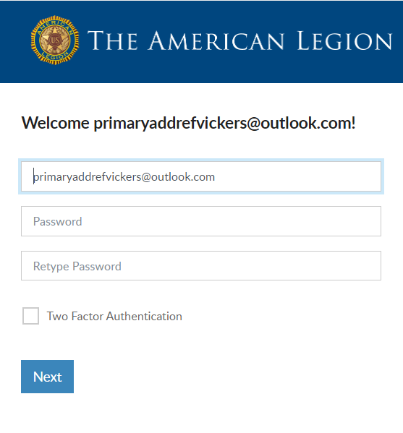
STEP 3: CREATE PASSWORD
Password Requirements:
Uppercase Letter
Lowercase Letter
Number
Symbol (!@#$%^&*)
8-character Minimum
Two Factor Authentication
​
Requires identity verification code sent via Email​
Notes:
Members will receive a welcome window to complete the final step, create a password.
The username defaults to the email address entered. It is recommended to leave the email address as your username. However, you can update the username in this window by updating it in the Username field. When creating a username, try to use something unique.
<1> Two-factor authentication is an extra layer of security to ensure that you're the only person who can access your account, even if someone knows your password. This extra security measure requires you to verify your identity using a randomized code we’ll email you each time you attempt to log in. Applying this feature is available when you first create your account. It can be added or removed later through your account.
Click “Next” to proceed.

Slide 9
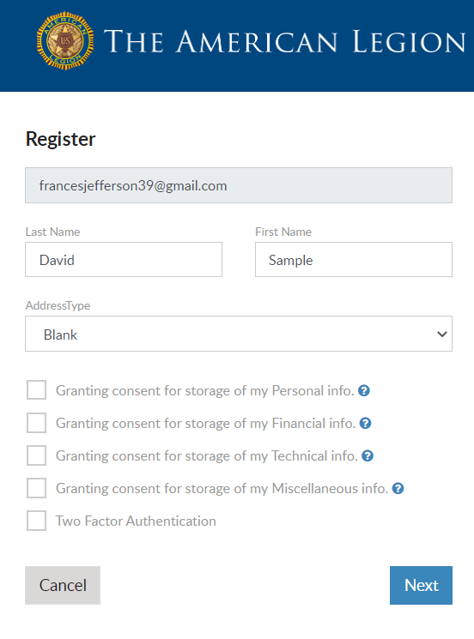
CAUTION!
If you are a member of The American Legion or Sons of the American Legion and receive this registration window, click Cancel.
Did you enter your email address correctly?
Update Email address on your membership record and re-register.
primaryaddrefvickers@outlook.com
Notes:
Members of The American Legion and Sons of the American Legion should not proceed if this window appears. Continuing will not connect to your membership details.
The email address entered, must match what is on file at national headquarters. Members should <1> Double check how the email address was entered. Was it entered correctly? If not, cancel and try again. <2> If it is entered correctly, click Cancel and contact your local or department leadership or national customer service to update your primary email address.

Slide 10
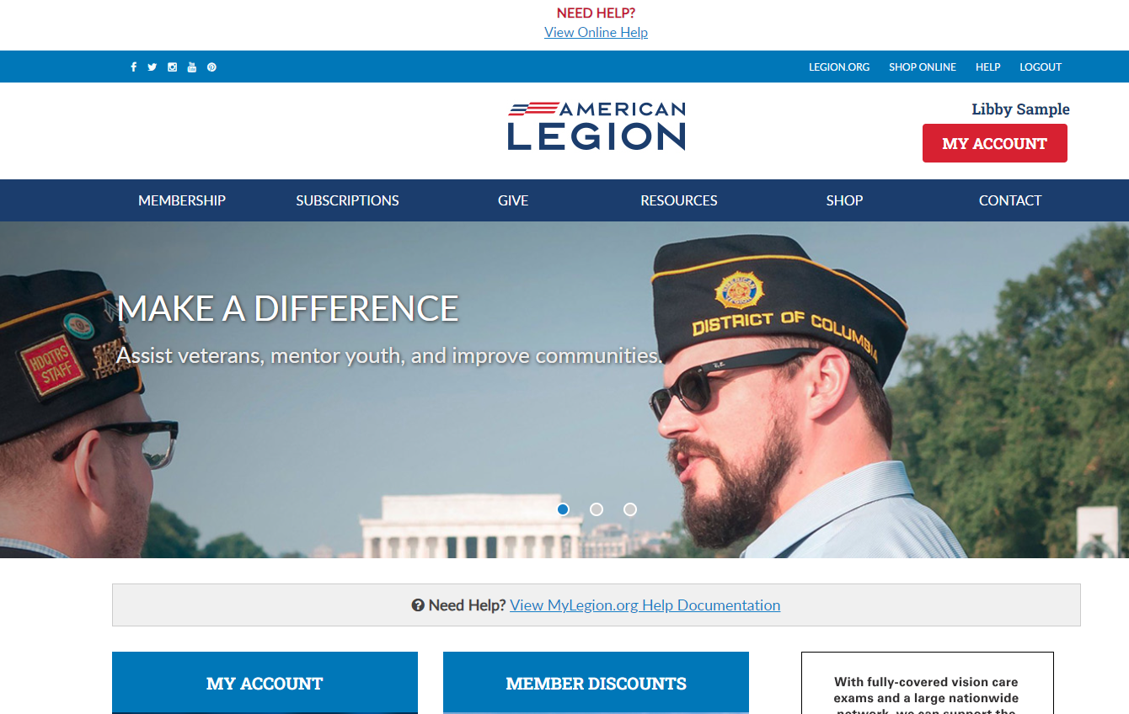
Notes:
Successful registration opens the MyLegion Home page that also provides links to legion.org.
Click My Account to view and manage information on file for your membership record, at national headquarters.

Slide 11
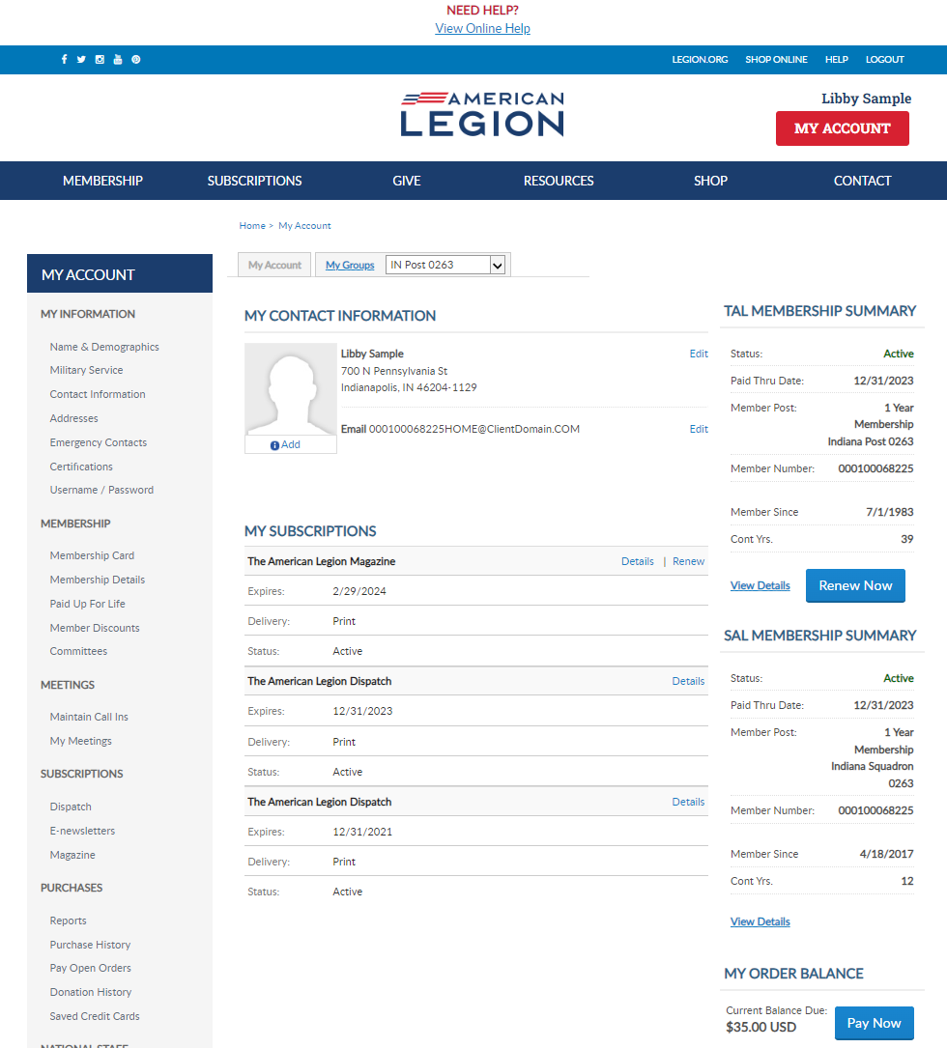
primaryaddrefvickers@outlook.com
000123456789
2024 renewals available July 1, 2023
000123456789
Notes:
My Account provides membership details and other online tools. Learn more about managing your account using online help resources. <1>
Adjutants and Commanders will have an additional My Groups menu. <2>
Beginning July 1, 2023, Legion and SAL members can renew 2024 membership. When your membership is eligible for renewal you can renew through MyLegion. Click on Renew Now or Pay Now to proceed to online renewal.

Slide 12
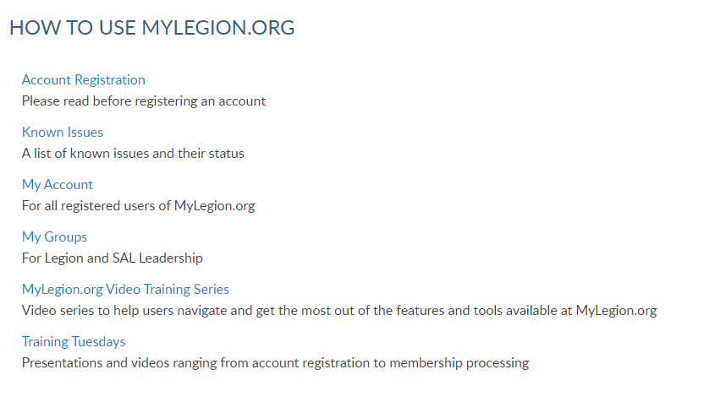
Notes:
MyLegion help offers step by step instructions, videos, and training presentations for both member management and officer tools.

Slide 13
Email:
mylegion@legion.org
Phone:
833.253.9995
Notes:
Your National support staff is available Monday through Friday, 8-4:30pm Eastern.

